Slide 1













Regression of
Commute Time
Presented by Fahimul Alam

Slide 2

Objectives
To analyze factors influencing daily commute times
To find a suitable regression algorithm for the dataset.

Slide 3
Handled missing values using median imputation for numerical columns and mode imputation for categorical columns.
01.
Data Preprocessing
Label encoded categorical features to numerical representations and Scaled numerical features.
02.
03.
Removed outliers from numerical features using the IQR method.

Slide 4
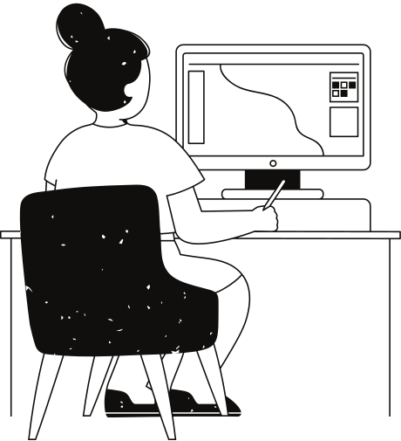
EDA
The most frequent age is around 24-27 years old.
Most people live 3-7 km away from their workplace.
Daily commute time spikes around 75 and 200 minutes.
Most people use the BUS as their transportation medium and experience medium to high traffic.
A linear relationship between 'Daily commute time' and 'Distance from home to workplace(KM)' was observed.

Slide 5
Model Development and Evaluation
01
Linear regression was chosen due to the linear relationship between distance and commute time seen in the EDA.
The model performance shows that distance, traffic, and mode of transportation are important factors when predicting commute time.
Mean Squared Error: 1486
R-squared (R²): 0.55

Slide 6
Key Takeaways
&
Recommendations
Major Points
Suggestions
Distance to work is a significant factor in commute time
Traffic during commuting significantly impacts commute time.
Transportation method also affects commute time
Modularize the system
Explore non-linear models
Collect more data

Slide 7
Thank you very much!

